Slide 1


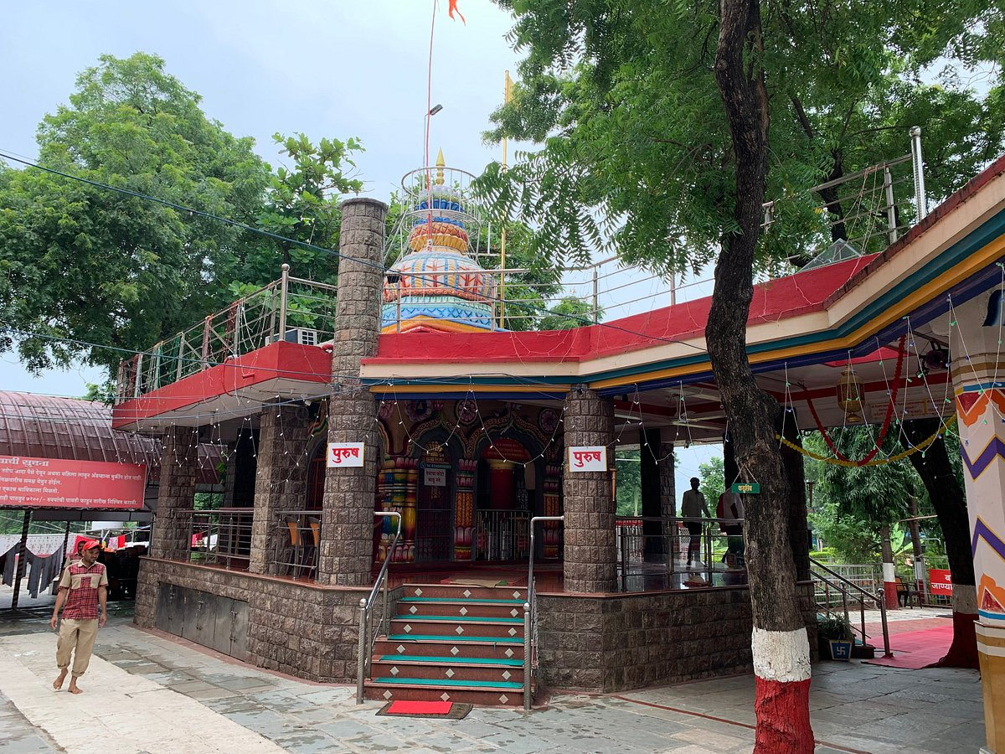
Presentation of
Jalgaon District Strategic Plan
Presented By,
District Collector, Jalgaon
Date : 17th January 2025

Slide 2

Part 1 – Jalgaon District Profile and SWOT Analysis

Slide 3



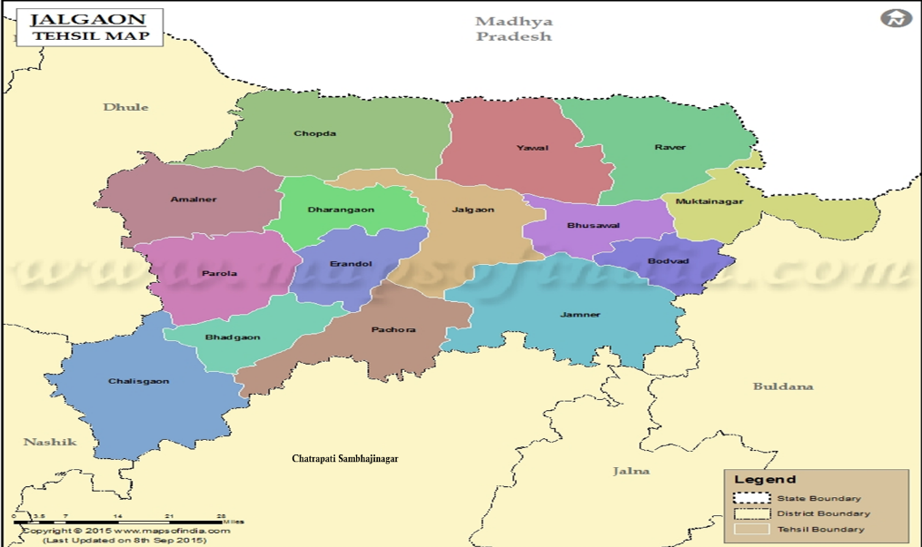
JALGAON DISTRICT – AT A GLANCE
Population
42.29 Lakhs
(As per 2011 Census)
48.97 Lakhs
(Projected Population)
Area
11,765 Sq.Km
Area Under Forest
1773.34 Sq. Km (15.1%)
Area Under Cultivation
8.41 Lakh Hec
Area Under Irrigation
3.70 Lakh Hec
HDI - 0.723
(HDI Report 2012)
Literacy Rate = 78.2
(2011 Census)
Highest Banana Producer in Maharashtra (The Jalgaon district of Maharashtra produces around 70% of the state's banana production. Jalgaon is known as the "Banana City of India“)
Major crops : Banana, Cotton and Millet
KNOWN FOR : Gold Processing, Plastic Industries, Cotton Ginning Mills, Dal Mills
Current Economic Snapshot
Economy Size: ₹76,000 crore.
Sectoral Contribution and Growth:
Sector % of GDDP Growth Rate (CAGR)
Agriculture 17% -1.43%
Industry 35% 0.86%
Services 48% 4.15%
GDDP CAGR (2011 to 2021) at Constant Prices
Current CAGR | 1.10
Required CAGR rate for 2024-29 | 17.7
Growth Aspiration
India | 5 Trillion
Maharashtra | 1 Trillion
Jalgaon | 25 Billion
Decadal Growth Rate - 14.86 %
Notes:
History. Tourist Attraction, Geography hills geographical map, cropping patterns, demographic data, economy data service growth , admin rearrange it.

Slide 4
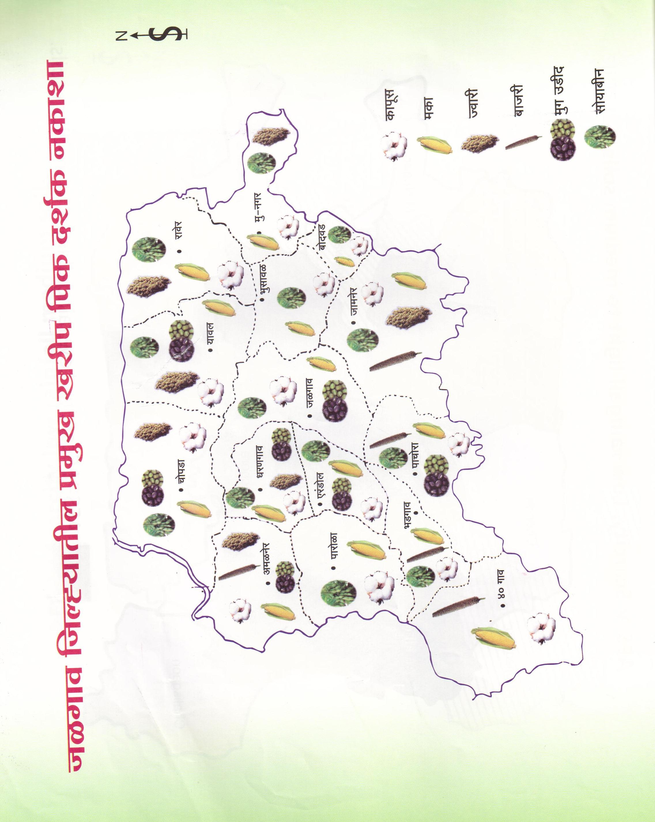
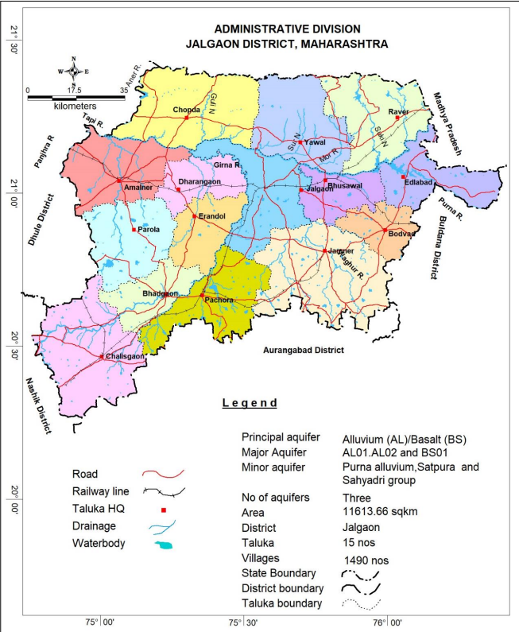
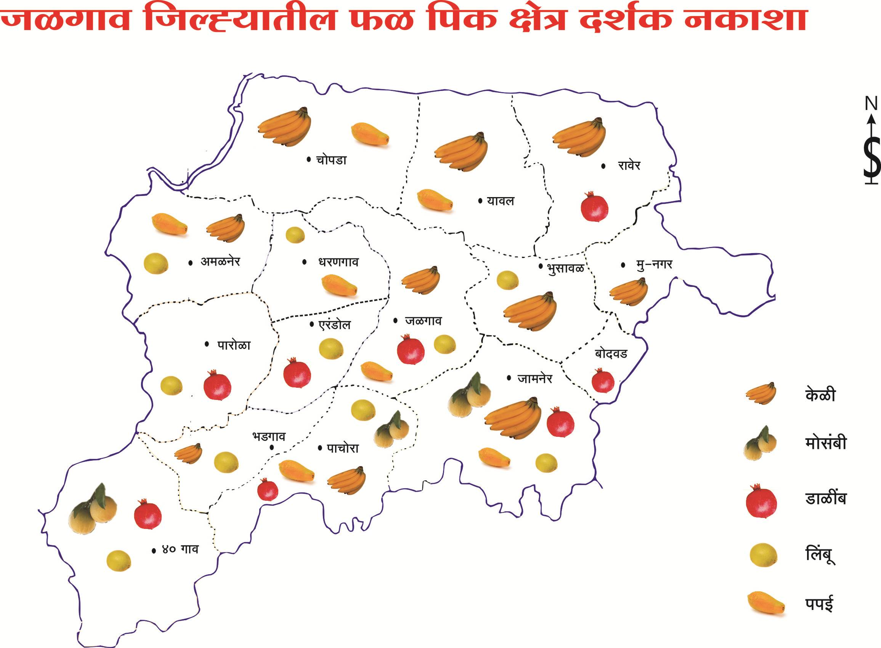
MAP OF NH / RAILWAYS AND AGRICULTURE PRODUCTS
Cropping Pattern:
Banana= 64,964 Ha. Oilseeds = 21,716 Ha. Cereals = 2,07,122 Ha. Cotton = 5,62,263 Ha. Pulses = 1,10,788 Ha. (Maze is emerging crop in Jalgaon)

Slide 5

Vision
“Ensuring Jalgaon’s sustaible growth targeting a 17.7% CAGR until 2028 for economic prosperity, technological advancements and inclusive development inline with the SDGs”
Primary
Secondary
Tertiary
Agriculture – Banana and Cotton
Animal Husbandry
Post Harvest Management
Fishery and Aquaculture
Forest
Agro Processing / Food Processing
Plastic Processing
Textiles
Editable Oil Manufacturing
Real Estate
Gold Processing
Tourism
Banking
Railway
Identified Primary, Secondary and Tertiary sectors by BCG Matrix and EAC recommendation.

Slide 6


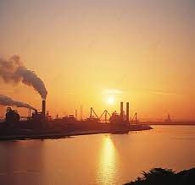


Aim & Objective
1st rank in FDI Inflow.
Rapid & Comprehensive Economic Development (2024-2029)
Increase Jalgaon's GDP to US $25 Billion (at 2022 prices) by 2028-29
Increase the per capita income from ₹1.52 Lakh to ₹3.91 Lakh per annum
Reduce poverty from 13.1% (as per NHFS 5) to 0.1% of the population.
Improve wealth distribution by reducing the Gini coefficient from 0.277 to 0.201

Slide 7






SWOT ANALYSIS: District
STRENGTHS
WEAKNESSES
OPPORTUNITIES
THREATS
Fertile black soil & Water
Land Bank
Leading banana producer & Developed Market linkages
Strong gold and plastic industry
CD ratio of 73 %
Railway Network
National Highway (400+ km)
Power Generation
High dependence on agriculture.
Poor workmanship
Under developed Industrial Infrastructure
Highest Consumer of fertilizer in India
Unsustainable agriculture practices due to depleted ground water and lack of value addition
Agro-processing
Industrial cluster development.
Logistic hub
Chain
Leveraging agro-processing for exports.
Agri Tech
Defence
Climate change.
Lack of Power Subsidy
Lack of high Talent
Ground water depletion

Slide 8

Part 2 – Agriculture Sector

Slide 9
“One Crop One Block”
Proposed Initiatives
Key Agricultural Programs
Value Addition in Agriculture
Innnovation
Raver, Jalgaon, Yawal – banana
Erandol, Dharangaon, Amalner, Parola – Cotton
Bhusawal – Soyabean
Erandol Maize
Chopda -Pomogranates 6. Parola – Toor Dal
Crop Diversification - Promote dragon fruit, pomegranates, and intercropping with cotton
Value Addition - Establish banana processing units for chips, pulp, and fiber
Cold Chain Development - Develop storage & transport facilities with subsidies
Water Managemen - Drip and sprinkler irrigation to improve water use efficiency
Banana Processing - Proposed fiber extraction and pulp production for export.
Dal Milling - Upgrading processing for pulses like toor dal.
E-Commerce Platforms - Direct farmer-buyer market linkages to reduce middlemen.
Converting banana stems into eco-friendly fibers for textiles, (Philippines successfully exports banana fibers for high-end fabrics.)
Impact : Additional income of INR 10,000 per acre for farmers
Proposed Action Plan –
1. Fiber Extraction Units- Rs. 15 Cr (2023-2025) 2. Farmer Training Programs – Rs. 5 Cr (2023-2024) 3. Export Facilitation Rs. 10 Cr (2024-26)
Convert gayran land to biomass-producing areas.
Convert Primary Agricultural Credit Societies (PACS) to FPO
Water User associations into FPO

Slide 10
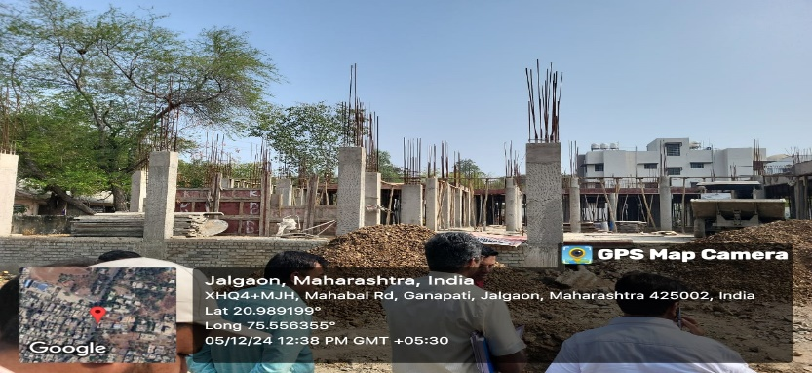
Major Irrigation Projects
Status:
Major 8 Irrigation Projects are Likely to Complete in Jalgaon District
Benefits:
8 Irrigation Project having Project Irrigation Capacity of 2,65,785 Ha. After completion of these projects extra 1,94,270 Ha area will be under irrigation , thereby supporting the goal of increased cropping intensity
Non-Productive Land Identification
Identified Land Tyeps:
1.Dam Side Lands
2.Gairan Lands
3. Depleted Lands – 148CFR
Objective: To rehabilitate or repurpose these lands for productive agricultural use, potentially through techniques like soil conservation, afforestation, or alternative farming practices.
Farm Ponds and Sustainable Farming
Farm Ponds:
Proposed Construction of 2,020 farm ponds under the Lift Irrigation Scheme in Jamner Taluka.
Aquaponics and Hydroponics: Proposed Hydroponic for Vegetables & 3 Types of Aquaponics practices in the farm ponds can allow for year-round cultivation, enhancing food security and income for farmers.
Support for Dal Mills
Current Challenge
Local dal mills are facing challenges due to a shortage of raw materials, particularly dal.
Proposed Solution:
Providing raw material supply assistance to local dal mills by increasing area under pulses (Moong Dal, Balck gram Udid Dal, Chickpea lemtil Chana Dal, Arhar Dal Toor Dal)
Promote intercropping with cotton and conduct campaign.
Cropping Intensity Enhancement
Current Status:
The district's cropping intensity stands at 1.28.
Target:
The objective is to increase this intensity to 2.10, aiming for more efficient land use and higher agricultural output
Dairy
Year | Proposed Fund (Lakhs) | Doses
2024-25 | 20.00 | 2000
2025-26 | 20.00 | 2000
2026-27 | 20.00 | 2000
2027-28 | 20.00 | 2000
2028-29 | 20.00 | 2000
8.46 Lakhs Cattle & Buffalos in Jalgaon District as Per Census of Livestock 2020
4188 Cattle Shades Provided through MGNREGA
Ongoing Construction of Artificial Insemination Centre at Jalgaon through DPC
High Quality Breed with Improved Productivity Sex Sorted Semen Doses Proposal

Slide 11
One Year Plan Initiatives - Agriculture
 | Objective | Specific Intervention Required | Physical Target for 1 years | Cumulative Estimated Cost (in Lakh) | Funding Source | Activity Status | Target Achieved | % Target Achieved | Implementing Agency | Conclusion regarding Implementation
Primary-Crops | Effective Water Management | Increasing the number of Artificial Ponds in agriculture fields by subsidizing the creation of Artificial ponds (Shet Tala) which will retain natural rainwater. | 300 | 240 | State/Central Scheme | Completed | 264 | 88 | DSAO saojalgaon@gmail.com | Target 300 Ponds and Cost 240.00 Lakh Physical 264 Financial 204.03 Lakh Employment potential 80808 Agency to do work Agriculture Chief Minister Sustainable Agriculture Irrigation Scheme (Updated on 07/01/2025)
 |  | Increase the area under foliar application, drip irrigation and fertigation facility by extending subsidy schemes for Nano Application (Eg use of NANO DAP and NANO Urea and Micronutrient) by giving Demo Units | 3750 | 56.2 | State/Central Scheme | In progress | 1500 | 40 | DSAO saojalgaon@gmail.com | 1500 Farmers covered under National Food Security Mission Mapping of scheme/ Fund from existing scheme - NFSM/State schemes for crop production) (Till Date 07/01/2025)
 |  | Implement Ground Water Recharge scheme | 90 | 752.00 | State/Central Scheme | Revised Estimates as per latest DSR is in process | 0 | 0 | GSDA sgjalgaon.gsda@maharashtra.gov.in | Revised Estimates as per latest DSR is in process 135 proposals shared with Disaster Management Branch. Collectorate Jalgaon. Atal Bhujal Yojana. Summary Received. 90 Villages will be covered

Slide 12
 | Objective | Specific Intervention Required | Physical Target for 1 years | Cumulative Estimated Cost (in Lakh) | Funding Source | Activity Status | Target Achieved | % Target Achieved | Implementing Agency | Conclusion regarding Implementation
Primary- Crops | Promote Crop Diversification | Introducing improved cultivation practices like INM/IPM/ICM- Demo Plots with package | 3750 Plots | 150 | State/Central Scheme | In Progress | 2250 Plots | 60 | ATMA pdatma.jalgaon@gmail.com / KVK | Target 3750 Plots Physical 2250 Farmers Area 2250 Hector Financial 6.90 Lakh National Food Security Mission (Till Date 07/01/2025)
 |  | Technical support by providing ICT tools in terms of identifying high-value crops and their cultivation practices etc.as per the geographical conditions. | 5 | 22 | State/Central Scheme | In Progress | 25 | 500 | DSAO saojalgaon@gmail.com / ATMA | 25 beneficiary benefited under the Mission for Integrated Development of Horticulture (MIDH) (Till Date 07/01/2025)
 |  | Financial support (incentives/subsidies) etc for cultivation of high-value crops for fruits, vegetables and Banana (Polyhouse/Greehouse/Nursery/Packhouse) | 30 Polyhouse/ Greenhouse/ Nursery/ Packhouse | 450 | State/Central Scheme | In Progress | 15 | 50 | DSAO saojalgaon@gmail.com | Achievement up to 30.11.2024 Physical 15 (Poly House/GreenHouse/ShedNet) Area 4.82 Hector Financial 180.75 Lakh (Mission for Integrated Development of Horticulture and MGNREGA) (Till Date 07/01/2025)

Slide 13
 | Objective | Specific Intervention Required | Physical Target for 1 years | Cumulative Estimated Cost (in Lakh) | Funding Source | Activity Status | Target Achieved | % Target Achieved | Implementing Agency | Conclusion regarding Implementation
Primary- Crops | Promote Crop Diversification | Capacity Building for improved cultivation technology in order to diversify farmers towards high value crops.- | 15 | 60 | State/Central Scheme | Completed | 22 | 146.67 | ATMA pdatma.jalgaon@gmail.com | Capacity building under ATMA scheme target of 15 farmers group formation against we formed 22 this year (2024-2025) (ATMA/STRY) (Status updated on 07/01/2025)
 |  | Diversification of Crop variety for main crop Banana with different variety | 300 Ha | 56.2 | State/Central Scheme | Completed | 750.44 | 250.15 | DSAO saojalgaon@gmail.com | Target 300 Ha Physical 750.44 Area 300 Hector Financial 624.06 Lakh (MGNREGA)
 |  | Awareness campaigning for organic farming and balanced use of fertilizer through application of organic inputs (Green Manure, Vermicompost Biofertilizer and Bio Pesticides) | 15 | 7.5 | State/Central Scheme | Completed | 190 | 1266.67 | ATMA pdatma.jalgaon@gmail.com | Target 15 Physical 190 training achieved till date 11/12/2024 Financial 9.50 Lakh Additional Information:- Under The Paramparagat Krishi Vikas Yojana (PKVY)-organic and The Panjabrao Deshmukh Naisargik Sheti Mission (PDNSM) scheme 190 farmers group completed.

Slide 14
 | Objective | Specific Intervention Required | Physical Target for 1 years | Cumulative Estimated Cost (in Lakh) | Funding Source | Activity Status | Target Achieved | % Target Achieved | Implementing Agency | Conclusion regarding Implementation
Primary- Crops | Driving agricultural efficiency with widespread mechanization for sustainable farming | Tractors and Trailers through Subsidized scheme | 160 | 1320 | State/Central Scheme | In Progress | 71 | 44.38 | DSAO saojalgaon@gmail.com | Physical 263 Farmers Financial 129 Lakh State Agriculture Mechanisation Scheme/RKVY/Submission
 |  | Increase KCC Accounts | NA | 400000 |  | In Progress | 233220.26 | 58.31 | LDM ldmjalg@centralbank.co.in | 108783 KCC Accounts
 |  | Threshers Through Subsidized scheme | 60 | 280 | State/Central Scheme | In Progress | 13 | 21.67 | DSAO saojalgaon@gmail.com | Physical 84 Threshers Financial 97.46 Lakh State Agriculture Mechanization Scheme/RKVY/Submission
Primary-Fisheries | Strengthening the existing Fisheries Society's | Support mechanism for improving the efficiency of underutilized resources. | 13 | 100 | DPC | Completed | 30 | 230.77 | Asst. Comm., Fishery Dept. acfjalgaon@gmail.com | Proposal Sanctioned of Rs. 1.80 Lakhs for 30 Beneficiaries (nylon sut jali subsidy)
Primary- Animal Husbandry | Increase number of high yielding cows, buffalos, goat and poultry etc. | Construction of New Veterinary Health Clinic | 15 | 742 | DPC | In Progress | 23 | 153.33 | Dy. Comm. Animal Husbandry ddcahjalgaon@gmail.com | 2 ZP and 6 State Hosp. Sanctioned in 2024-25 regular fund, 15 ZP Sanction in RE 2024-25

Slide 15
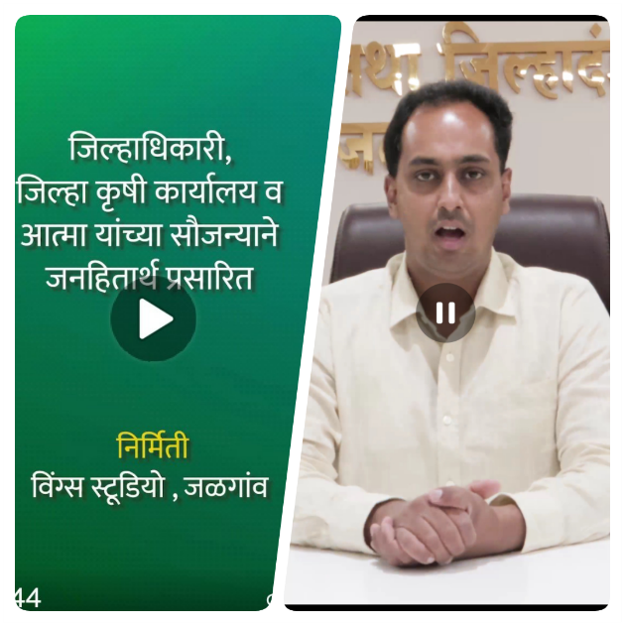
Intercropping Programme
Dal Mill Industry in Jalgaon was faceing Problem of avaibility of Raw Material (Dal) in Jalgaon District
District Administration and Agri Department Initiated to encourage for Intercropping to the farmers in Year 2023-24 to to take Dal intercrops specially in Cotton to fullfill need of Dal Mills in District
It seems Increase in area sown from 40107 Ha to 44845 Ha’
Total increase in area sown under Pulses is 11.81 %

Slide 16
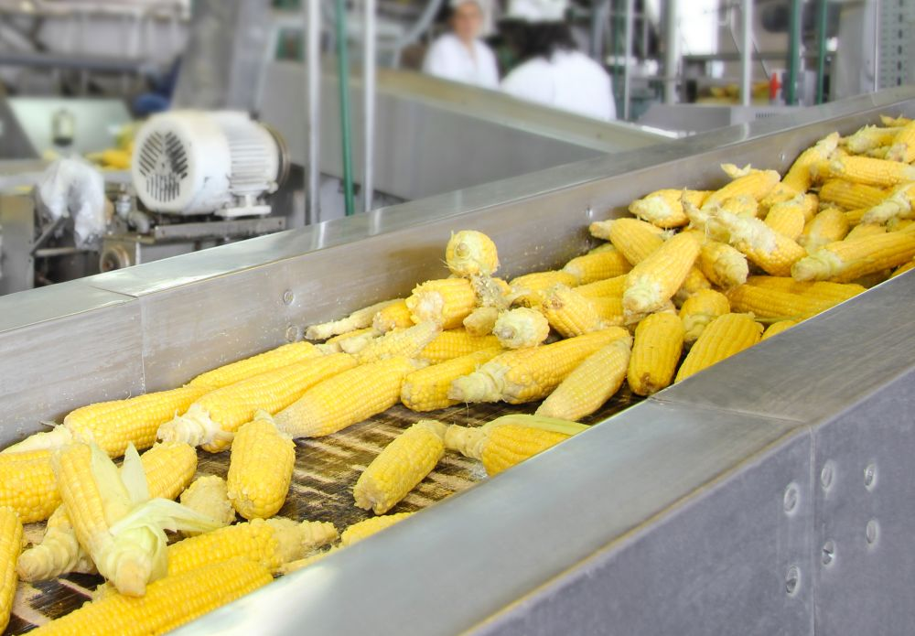
Part 3–Agriculture / Food Processing Sector

Slide 17
Cotton
Production of Cotton:
Average Yield Cotton Per Acre in Jalgaon – 440 Kg
Average Yield Cotton Per Acre in Maharashtra - 550 Kg
Target to 800 Kg yield in Jalgaon through Improved Cotton varieties, Soil Mangent, Optimized Irrigation Techniques, Training and Education with Gov support
Ginning Mills:
Largest area under cotton (5.50 lakh hectares) with 35 ginning mills
Target to 65 Ginning Mills and Spinning mills to achieve 12% Growth
Require 800 MW power to start Spinning (660 MW Power Plant Upgradation in Progress at Deepnagar Bhusawal
Banana Fibre
Processing Units:
Proposed Storage Godown in 206 Villages with conversions of Schemes
Total Cost Per Unit – 26 Lakhs
MGNREG SHARE – 16 Lakhs
DPC SHARE - 10 Lakhs
Machinery is Provided Under PMEGP & PMFME
Encourage SME for processing of Banana Fibres
Horticulture Cluster Development :
National Horticulture Board announced Rs. 100Cr Banana Cluster under Horticulture Cluster Development Programme
Fruits
Category:
Producted Fruits will identified in Three categories
A Grade – Market Supply
B Grade – Wholesale Supply
C Grade - Waste
B Grade & C Grade foods are utilized For Manufacturing of Ice Creams
Indian Market : ₹20,000 crore by 2025, growing at 12% CAGR for Icecream
Location : Pachora
Capacity:
2,00,000 liters/day milk, 50–80 tonnes/day fruits, ~5,00,000 liters/day ice cream.
Pet Food
Establish Jalgaon as a pet food manufacturing hub.
Fish & Goat – Dog Food
Chicken – Cat Food
Market Segmentation:
Dog food (85.6%), cat food (14.3%).
Location :
Bhadgaon at WCD Land
Employment:
Generate 5,000+ jobs.
Farmer Benefits:
Increased income through contract

Slide 18
Ongoing Clusters Development
( Under Maharashtra State Industrial Cluster Development Programme)
Banana Processing
Spices Cluster
Products : Banana Processing
Talukas : Jalgaon (Bhadali)
(54 Beneficiaries)
DPR Approved and Construction work is in process. – May 2025
Budget : Rs. 2.17 Cr
Taluka : Jamner
(58 Beneficiaries)
DSR Approved and DPR prepration is in process. – Nov 2025
Budget : Rs. 6.00 Cr
Products : Spices Processing
Talukas : Jamner (50 Beneficiaries)
DSR Approved. DPR Preparation in Progress. Training in Progress. – Oct 2025
Budget : Rs. 7.00 Cr
Talukas : Bodwad
(40 Beneficiaries)
DSR Approved. DPR Preparation in Progress. First phase training completed. – Dec 2025
Budget : Rs. 2.50 Cr

Slide 19
One Year Plan Initiatives – Agro Processing / Food Processing
 | Objective | Specific Intervention Required | Physical Target for 1 years | Cumulative Estimated Cost (in Lakh) | Funding Source | Activity Status | Target Achieved | % Target Achieved | Implementing Agency | Conclusion regarding Implementation
Secondary- Food Processing | To Promote Sustainable Agri Business | Start a small-scale organic food processing unit, focusing on products like jams, sauces, and pickles using organically grown produce. | 5 | 200 |  | In Progress | 104 | 2080 | DRDA/ MAVIM/ SAO (PMFME)
 | Strengthening the SHG's | Establish processing units for banana and other crops, such as banana chips, millet flour, and ready-to-eat snacks. Support Agripreneurs (agri entrepreneurs) and farmers in setting up small-scale processing enterprises | 2 | 100 | State/Central Scheme | In Progress | 211 | 10550 | DSAO (PMFME)
Tetiary- Trade and Retail | Increase agro goods export | Establish godown in each village | 50 | NA | State/Central Scheme | In Progress | 7 | 14 | SAO / NFSM saojalgaon@gmail.com | 7 warehouses of FPO's subsidy of 12.5 Lakh each

Slide 20
One Year Plan Initiatives – Agro Processing / Food Processing (Cluster Development)
 | Objective | Specific Intervention Required | Physical Target for 1 years | Cumulative Estimated Cost (in Lakh) | Funding Source | Activity Status | Target Achieved | % Target Achieved | Implementing Agency | Conclusion regarding Implementation
Secondary- Manufacturing | To create agro Industries Eco system | Establish Banana Processing Cluster at Jamner and Jalgaon (Bhadali) | 2 | 700 | State Scheme MSICDP | In Progress | 0 | 0 | DIC महाव्यवस्थापक, जिल्हा उद्योग केंद्र जळगांव didic.jalgaon@maharashtra.gov.in | Jalgaon – Training completed, DPR Approved Construction work is in process at Bhadali (May 2025) 217.10 lakh -54 Beneficiaries Jamner – DSR Approve, DPR Prepration (Nov 2025) 600.00 lakh – 58 Beneficiaries
 |  | Establish Spices Processing Cluster at Jamner | 1 | 300 | State Scheme MSICDP | In Progress | 0 | 0 |  | DSR Approved, DPR Preparation under process, 1st phase training completed (Oct 2025) 700.00 lakh - 50 Beneficiaries

Slide 21
Part 4 – Industry Sector

Slide 22
Plastic Industry Development
Textile Industry Modernization
Formalizing Gold and Jewelry Industry
Agro-Processing Opportunities
1. Expand PVC product range to include high-value goods.
2. Promote recycling and circular economy practices.
1. Transition from only Ginning to garment production.
2. Enhance branding for global markets
1. Improve compliance and quality standards.
2. Establish Jalgaon as a jewelry trade hub.
1. Develop export-ready processing units of Banana
2. Upgrade dal mills for quality enhancement
3. Produce value-added products like corn starch
Objectives
Action | Details
Advanced Polymer Research | Establish R&D units for innovative products
Export Promotion | GST Recycled Solutions
Recycling Infrastructure | Develop plastic waste collection hubs
Action | Details
Integrated Textile Parks | Establish parks with dyeing, stitching units
Market Support | Provide quality certification centres
Skill Development | Train local workers for advanced techniques
Action | Details
Hallmarking Centres | Mandatory certification for authenticity
Artisan Skill Training | Train local craftsmen in modern techniques with Upskilling courses
Branding Campaigns | Promote Jalgaon as a gold retail destination
Facility | Budget (INR) | Location
Banana Processing Units | 30 crore | Chopda, Yawal
Pulse Processing Hubs | 25 crore | Jalgaon
Maize Processing Plants | 20 crore | Erandol, Parola
Proposed Actions

Slide 23
Ongoing Clusters Development
( Under Micro and Small Enterprises Cluster Development Programe)
Plastic Cluster
Garment Cluster
Products : PP Mats
Taluka :Jalgaon
Land Allocation in progress
Budget – 22.00 Cr
Products : Stichter Garment Cluster
Talukas :Chalisgaon
(301 Beneficiaries)
Construction work almost Completed - March 25
Budget – 8.90 Cr
Products :Swaymdip Garment Cluster (For Handicapped People)
(52 Beneficiaries)
Budget - 1.28 Cr
Activated / Executed
Under Micro and Small Enterprises Cluster Development Programe
Under Maharashtra State Industrial Cluster Development Programme

Slide 24
One Year Plan Initiatives – Industry (Cluster Development)
 | Objective | Specific Intervention Required | Physical Target for 1 years | Cumulative Estimated Cost (in Lakh) | Funding Source | Activity Status | Target Achieved | % Target Achieved | Implementing Agency | Conclusion regarding Implementation
Secondary- Manufacturing | Advancing to circular economy, minimizing plastic waste | Establishment of PP Mats cluster at Jalgaon | 1 | 2200 | Central Scheme MSECDP | Waiting for land allotment in MIDC | 0 | 0 | DIC महाव्यवस्थापक, जिल्हा उद्योग केंद्र जळगांव didic.jalgaon@maharashtra.gov.in | Waiting for land allotment in MIDC. Cluster development will implemented in MSECDP – 70 Manufacturer 2200.00 lakh
 | To create agro Industries Eco system | Establish Stitchers and Garment Cluster at Chalisgaon | 1 | 989.81 | State Scheme MSICDP | Completed | 1 | 100 |  | Swayamdip Women Association Garment cluster (128.00 lakh) - 60 Beneficiaries – Currently Active Stitchers Garment Cluster Chalisgaon (989.81 lakh) - 301 Beneficiaries (March 2025) Construction work under Process
 |  | Establish Spices Processing Cluster at Bodwad | 4 | NA | State Scheme MSICDP | In Progress | 0 | 0 |  | DSR Approved 1st Phase training completed (March 2026) 250.00 lakh - 40 Beneficiaries
State Support Require for:
Incentives to Power loom used in Plastic Industry.
Electricity duty waiver scheme for industrialization region.
A Scheme is proposed for establishment of common facilities to MSME’s (The facilities include common ETP, Storage and warehouse, cold storage etc.)

Slide 25
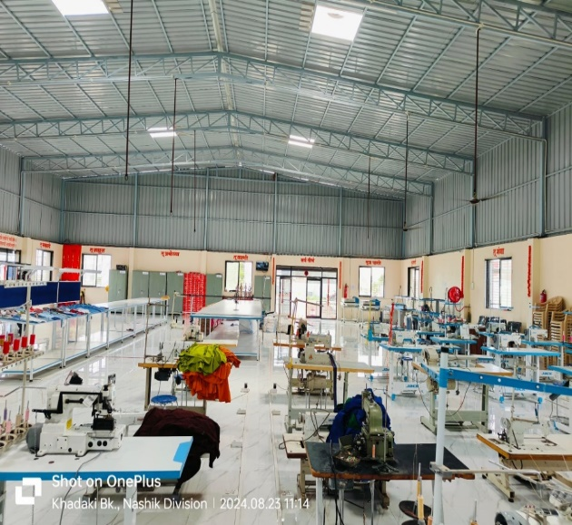
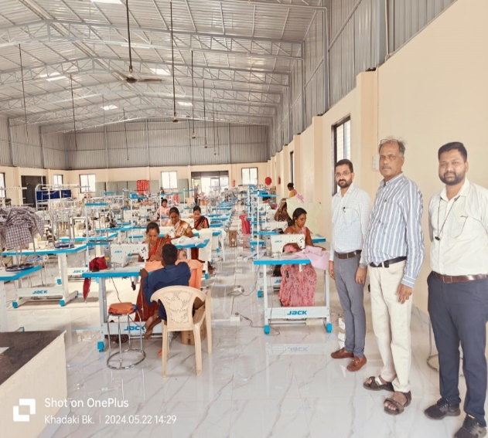
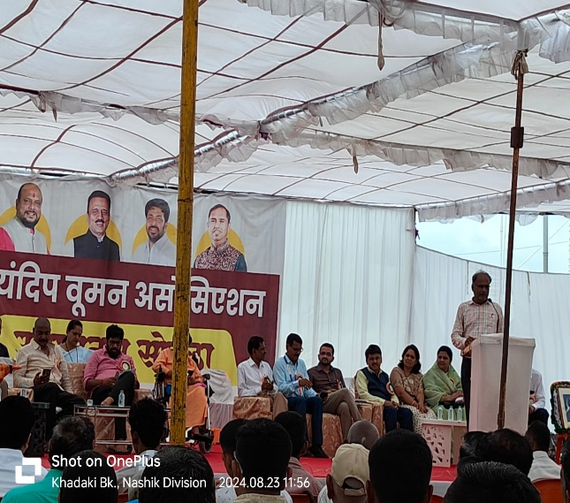
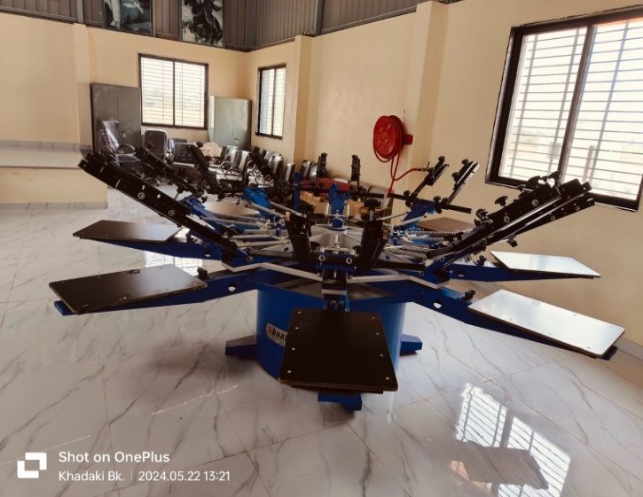
Swyamdip Women Association’s Garment Cluster, Chalisgaon
Swayamdeep Garment Cluster,Chalisgaon is physically challenged women lead project located in P-7,MIDC Chalisgaon.
Maharashtra’s first Cluster which most of the unit members are physically challenged.
Cluster funding scenario is as follows:-
(Amount in Lakhs Rs.)
Name of Scheme | No.of beneficiaries | Total Project Cost of CFC | Gov of Maharashtra Share (90%) | SPV Contribution (10%)
MSI-CDP | 60 | 128.33 | 115.50 | 12.83
Stitcher’s Garment Cluster, Chalisgaon has been sanctioned DPR and Tendering process for machinery as per DPR is completed by Industry Department.
Now Building construction of CFC is in process and it is intended that after machine setup cluster will commence from April 2025.
Swayamdip women association’s garment cluster,chalisgaon machineries set up & Inaugaration dated 23.08.2024

Slide 26
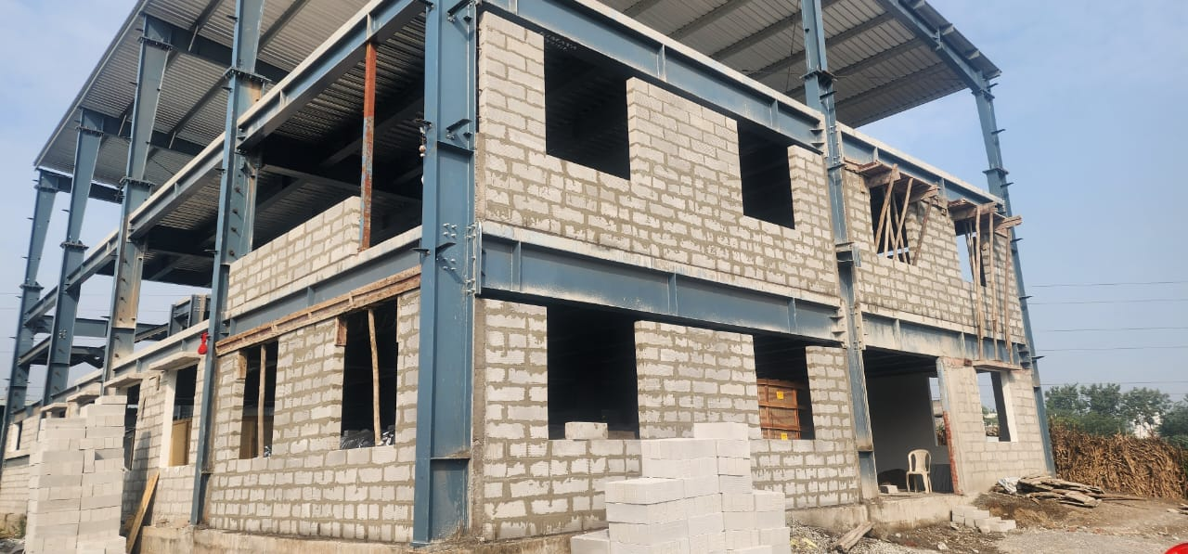
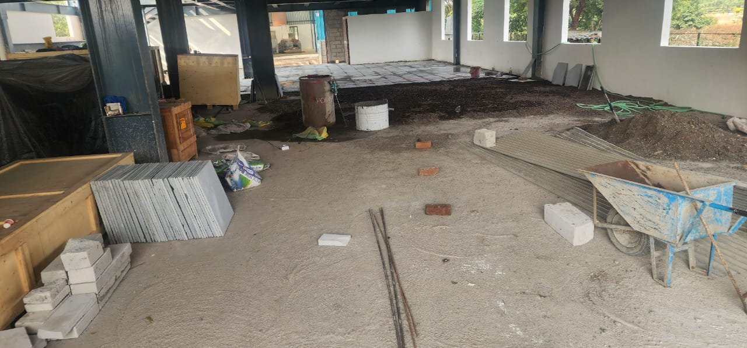
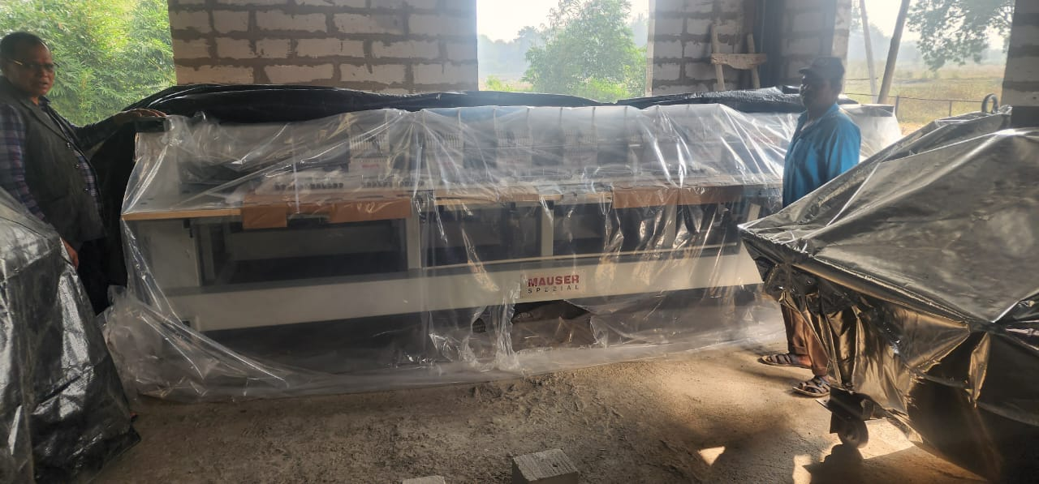
Stitcher’s Garment Cluster, Chalisgaon
Stither’s Garment Cluster,Chalisgaon is 2nd project under MSI-CDP Scheme located at Khadki Bk.,Chalisgaon.
It is another Project in Garment and Stitching sector after Swayamdip Garment Cluster Chalisgaon.
Cluster funding scenario is as follows:-
(Amount in Lakhs Rs.)
Sr. No | Name of Scheme | No.of beneficiaries | Total Project Cost of CFC | Gov of Maharashtra Share (90%) | SPV Contribution (10%)
01. | MSI-CDP | 301 | 989.81 | 890.83 | 98.98
Stitcher’s Garment Cluster,Chalisgaon has been sanctioned DPR and Tendering process for machinery as per DPR is completed by Industry Department.
Now Building construction of CFC is in process and it is intended that after machine setup cluster will commence from April 2025.
Photos of ongoing builiding construction and machinery of cfc at chalisgaon

Slide 27
Future Planned Industrial Clusters
The Ordnance Factory Varangaon (OFV) is located in the Jalgaon district spans a significant area of about 1,400 hectares (approximately 3,460 acres)
Its restructured by the Indian government into defense public sector undertakings (DPSUs) for the potential privatization or collaboration with private enterprises (Like Kanpur ordnance factory)
Poposal of Collabration with privatization for small arms and ammunition production
Its Targeted Result will be Exports of Rs. 25000 Cr which will boost District Economy
Porposed Scrap Material Hub
Location – Bhusawal
Electric Locomotive Yard is Located at Bhusawal, with Divisional Headquarter and Railway Junction with connection of main cities in country
Proposed to Establish Metal Recycle Unit at Bhusawal MIDC
Scrap will be proposed to recycle in following two parts
Railway Spare Parts
Automobile Parts
Nearly 8000 Gold Craftsman (Karagir) working in Jalgaon with Good Market of Gold
Objective: Establish Jalgaon as a leading gold thread and jewelry manufacturing hub, connecting with designers and shops nationally and internationally.
Set up a gold thread manufacturing Unit
Location – Jalgaon
To Set up online Platform for small gold manufacturer to connect nationally and internationally with Safe Courier System in Cluster Form
Jalgaon offers the advantage of good transportation links (via rail and road), proximity to suppliers, and access to a skilled workforce.
Maharashtra’s access to ports and industrial supply chains can help streamline sourcing of raw material to this industry
Location – Jalgaon
There is number of manufacturers of Plastic things in Jalgaon
Plastic industry if facing several Problems turns into closing units
To promote Plastic Industry Power Subsidies to be given for industries
Defence
IRON / STEEL
GOLD
BATTERY INDUSTRY
Plastic INDUSTRY

Slide 28
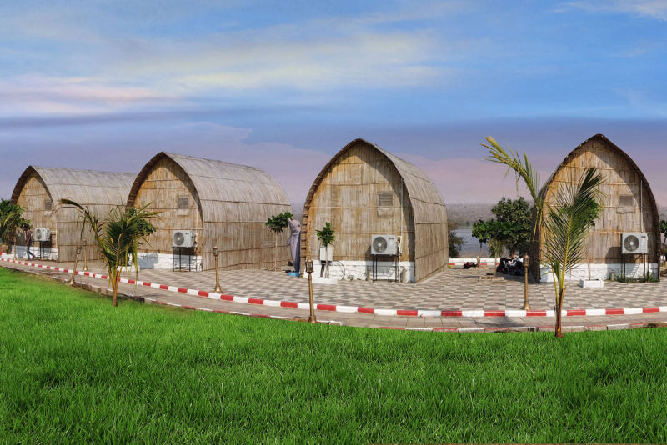
Part 5 - Service Sector

Slide 29
Tourism
Jalgaon has Big Potential of tourism with good connection of Road, Rail & Air Connectivities
Pal, Garkheda are Developed Tourism spots to attract Tourist via Tourism Department
Works are ongoing for Spiritual Tourism Spots like Padmalaya, Manudevi
Safari works are ongoing at Yawal Forest for Forest Tourism
It will Generate Nealry 5000 Employment in Jalgaon District
Medical Hub
There is Big Medical Hub Developing by Support of Governemnt with All Pathy’s (Viz. Allopathy, Ayurveda, Homeopathy, Dental, Physiotherepy)
Overall Bed Capacity - 850
Capacity of 150 MBBS Students, 70 MD MS Doctors in Various Streams for allopathy, 50 for Dental, 550 for Ayurveda, 160 for Homeopathy, Proposed Max 25 for Physiotherepy
Proposed to give Good Treatments and Facilities Through Surgical Excellance with providing all facilities in Hub.
It will Create 1100-2000 Jobs for Doctors, Nurse, Pharmauciticals, Admin & Support
Insurance
KBCNMU pursuing Acturial Statistics Programme.
Actuarial Statistics is a specialized field that focuses on the application of statistical methods to assess risks in insurance, finance, and other sectors.
Its great opportunity to provide facilities and encourage to insurance companies and Create Insurance Consultancy at Jalgaon
It will Create 60 Jobs per Year and generate employment around 500-1000

Slide 30
One Year Plan Initiatives – Tourism
 | Objective | Specific Intervention Required | Physical Target for 1 years | Cumulative Estimated Cost (in Lakh) | Funding Source | Activity Status | Target Achieved | % Target Achieved | Implementing Agency | Conclusion regarding Implementation
Tertiary- Tourism | To foster tourism in District | Development of Godri, Jamner for Eco Tourism | 1 | 300 | State Scheme | Proposal Sanctioned | 1 | 100 | उपवन संरक्षक, जळगाव (DCF Deputy Conservator Forest) | प्रस्तावास पर्यटन विभाग मधुन मान्यता प्राप्त – 492.27 लक्ष
 |  | Development of Wildlife Safari in Satpuda Ranges | 1 | 517.11 | DPC | Proposal Sanctioned | 1 | 100 | उपवन संरक्षक, यावल (DCF Deputy Conservator Forest) | प्रस्तावास DPC मधुन मान्यता प्राप्त – 100.00 लक्ष
 |  | Development of Tourism at Landorkhori, Jalgaon | 1 | 713 | DPC / State Scheme | Proposal Sanctioned | 1 | 100 | उपवन संरक्षक, जळगाव (DCF Deputy Conservator Forest) | प्रस्तावास DPC व पर्यटन मधुन मान्यता प्राप्त – 1000.00 लक्ष
 |  | Development Farkhande (Jhulata Manora) as a Tourist destination | 1 | 150 | DPC | Proposal Sanctioned | 1 | 100 | सहायक संचालक, पुरातत्व विभाग, नाशिक 0253-2507496 adanashik@gmail.com | प्रस्तावास DPC मधुन मान्यता प्राप्त – 148.00 लक्ष
 |  | Development Manudevi as a Tourist destination | 1 | 500 | State Scheme | Proposal Sanctioned | 1 | 100 | उपवन संरक्षक, यावल (DCF Deputy Conservator Forest) | प्रस्तावास पर्यटन मधुन मान्यता प्राप्त – 491.00 लक्ष
 |  | Development Unapdev as a Tourist destination | 1 | 150 | State Scheme | Proposal Sanctioned | 1 | 100 | उपवन संरक्षक, यावल (DCF deputy conservator forest) | प्रस्तावास पर्यटन मधुन मान्यता प्राप्त – 497.00 लक्ष
 |  | Development Sonbardi as a Tourist destination | 1 | 2800 | State Scheme | Proposal Sanctioned | 1 | 100 | मुख्याधिकारी जामनेर नगर परिषद, जामनेर | प्रस्तावास पर्यटन मधुन मान्यता प्राप्त – 2500.00 लक्ष
 |  | Development Mangalgraha as a Tourist destination | 1 | 500 | State Scheme | Proposal Sanctioned | 0 | 0 | कार्यकारी अभियंता सार्वजनिक बांधकाम विभाग अमळनेर amalner.ee@mahapwd.gov.in | प्रस्तावास पर्यटन मधुन मान्यता प्राप्त – 2500.00 लक्ष
 |  | Development Padmalaya as a Tourist destination | 1 | 500 | DPC | Proposal Sanctioned | 1 | 100 | कार्यकारी अभियंता सार्वजनिक बांधकाम विभाग अमळनेर amalner.ee@mahapwd.gov.in | प्रस्तावास DPC मधुन मान्यता प्राप्त – 290.00 लक्ष
 |  | Development Garkheda as a Tourist destination | 1 | 4000 | DPC | Proposal Sanctioned | 1 | 100 | कार्यकारी अभियंता सार्वजनिक बांधकाम विभाग जळगाव | प्रस्तावास पर्यटन मधुन मान्यता प्राप्त – 4000.00 लक्ष

Slide 31
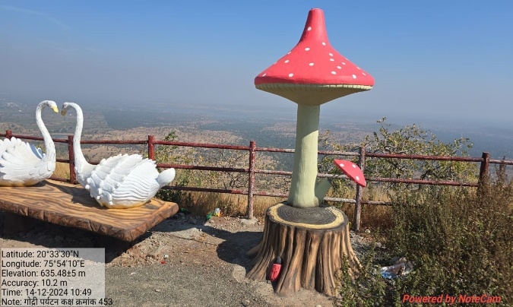
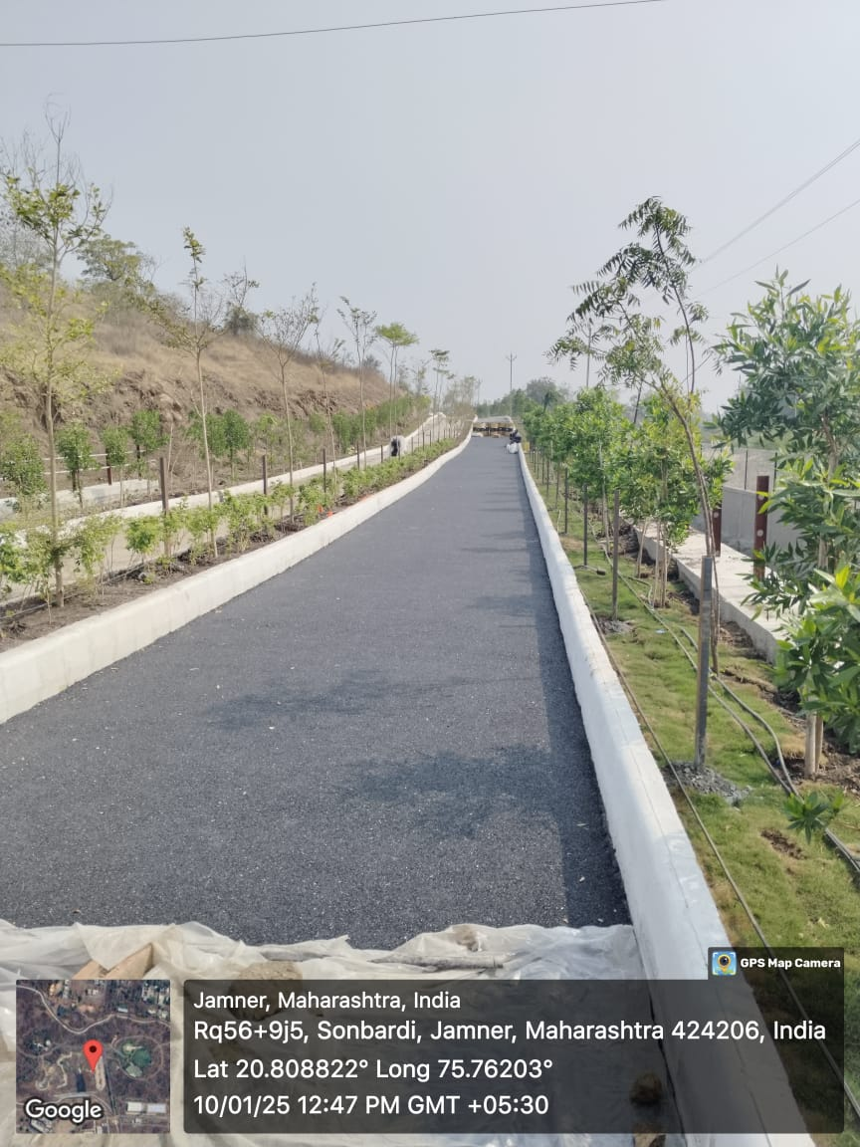
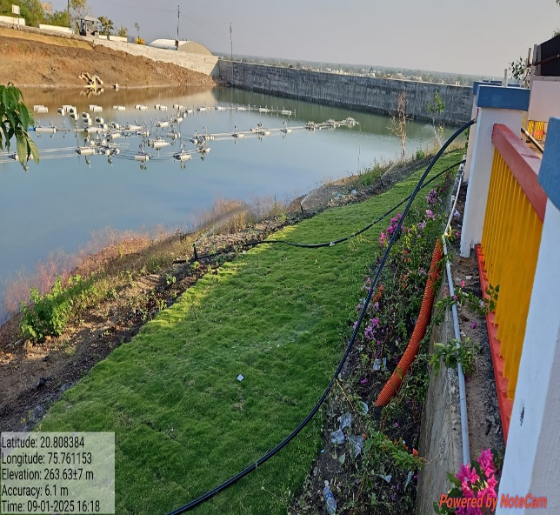
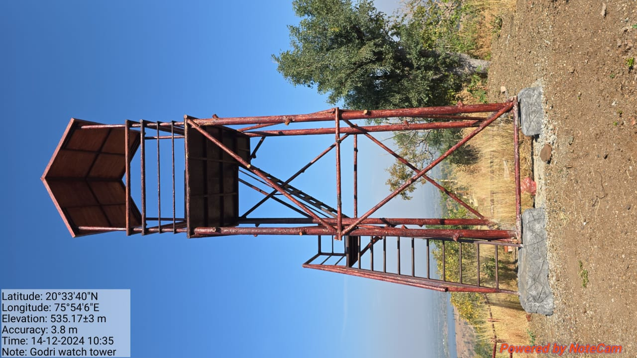
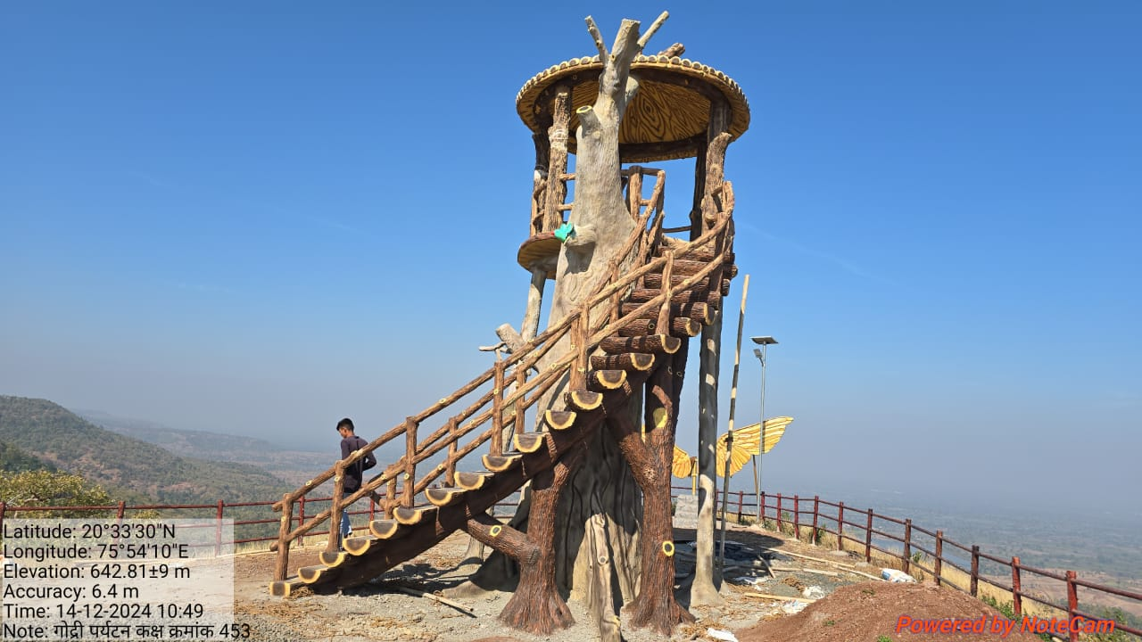
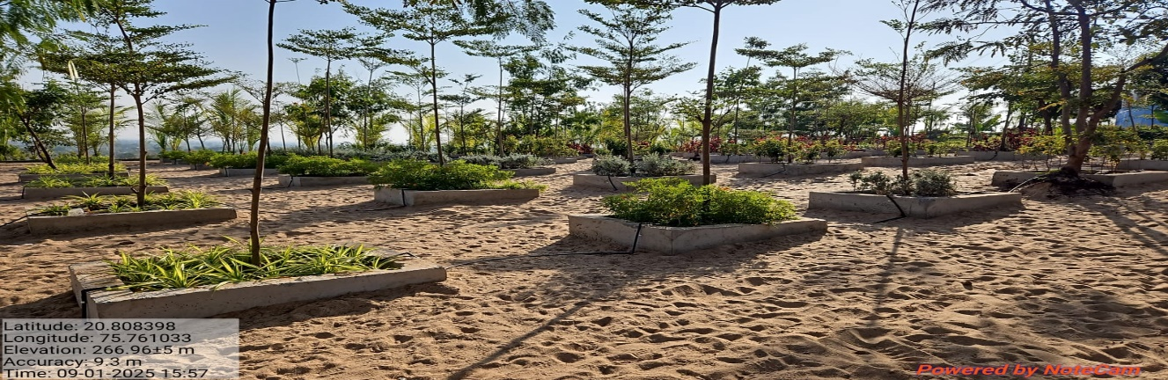
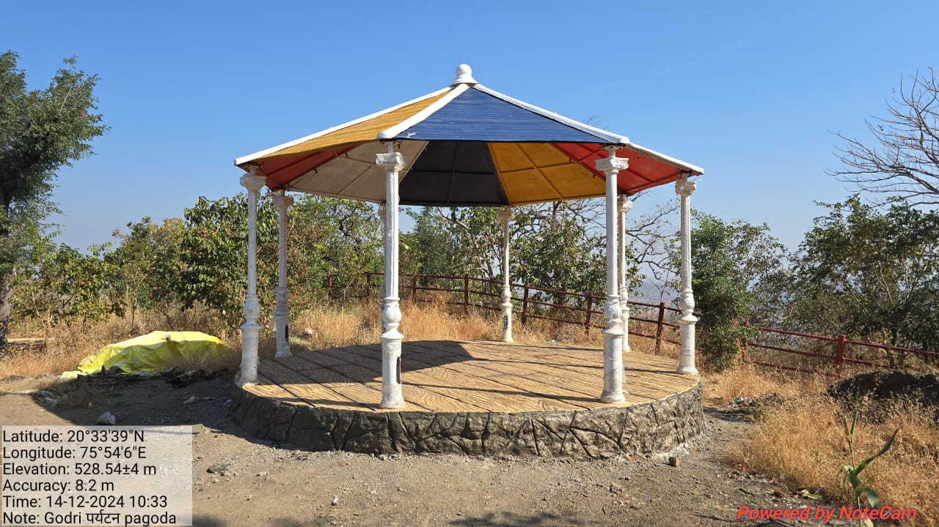
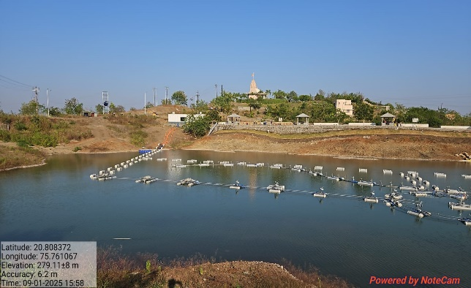
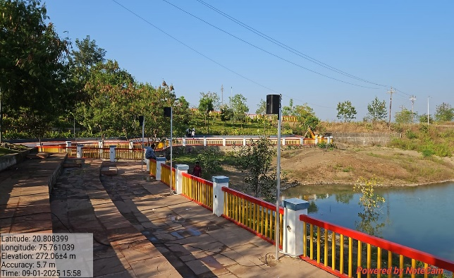
Tourism Development
Godri, Tal Jalmner
Sonbardi, Tal Jalmner

Slide 32
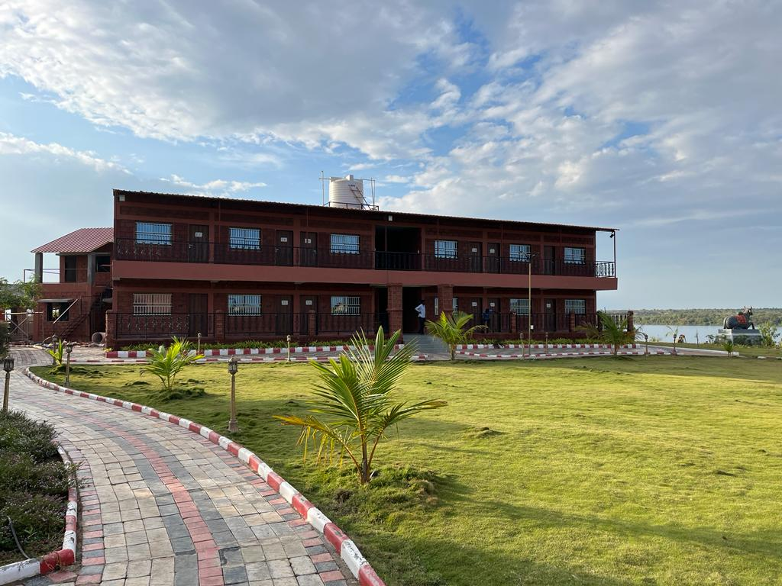
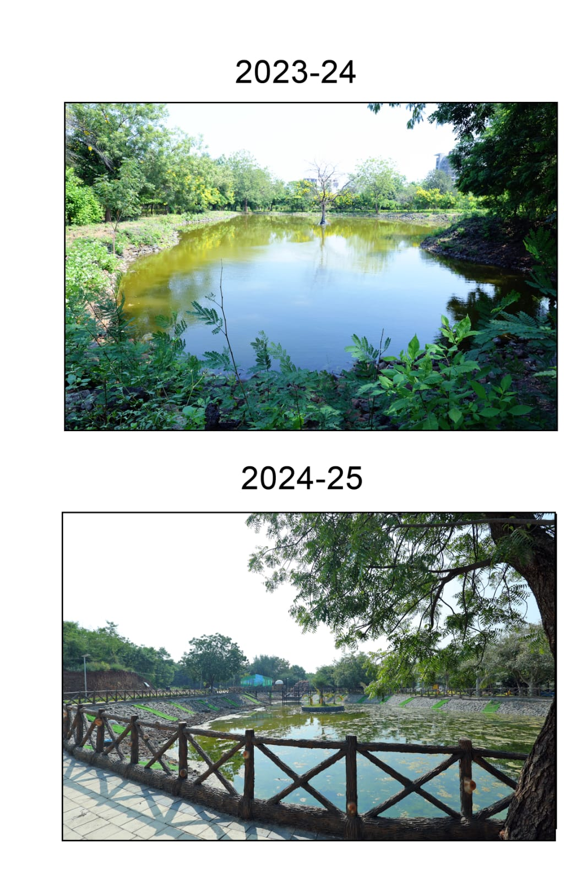
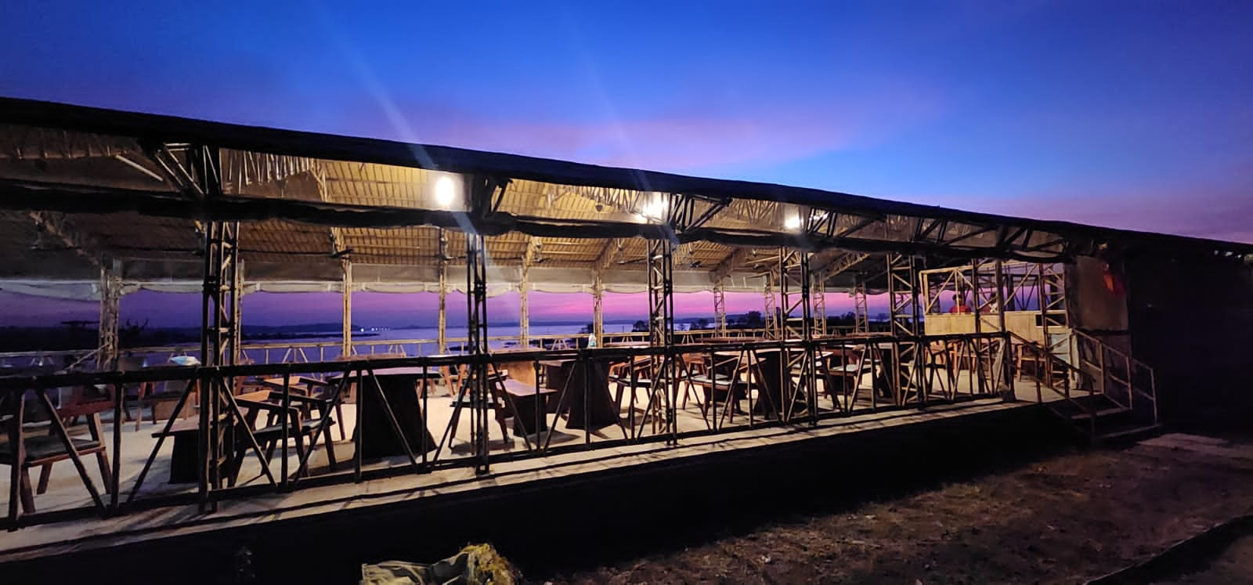
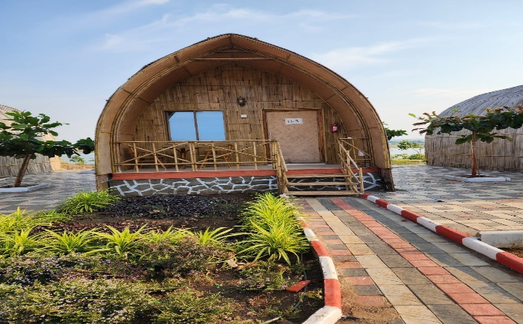
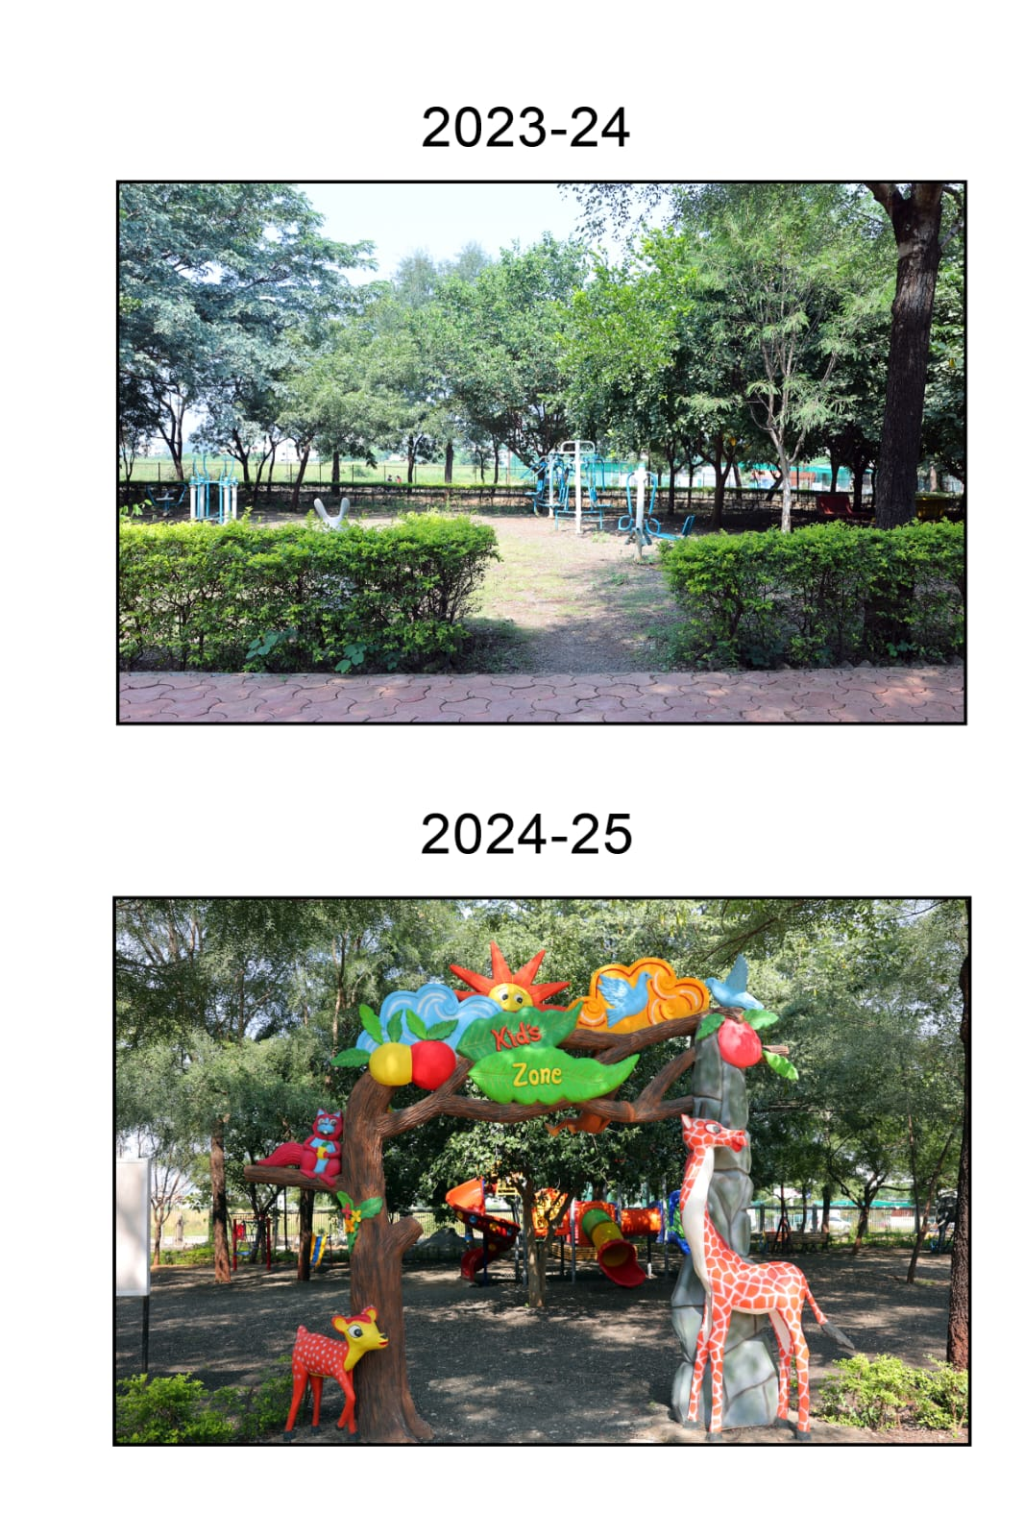
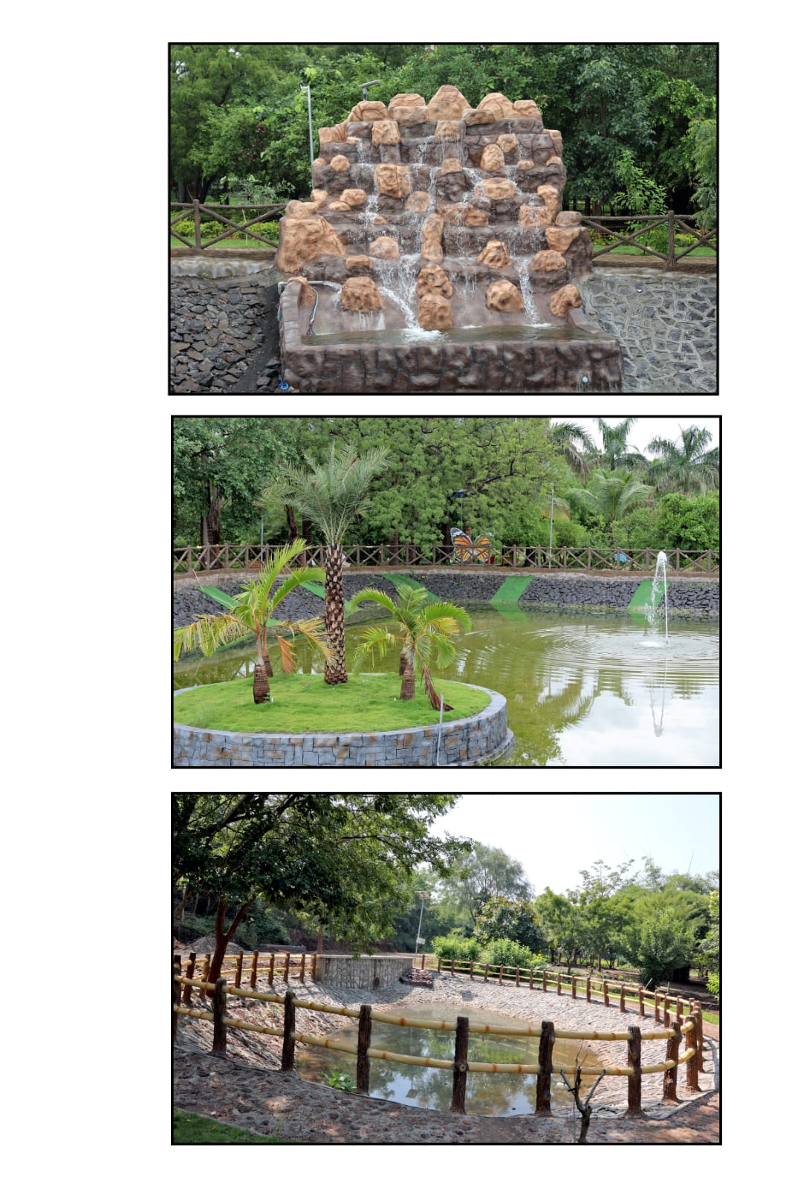
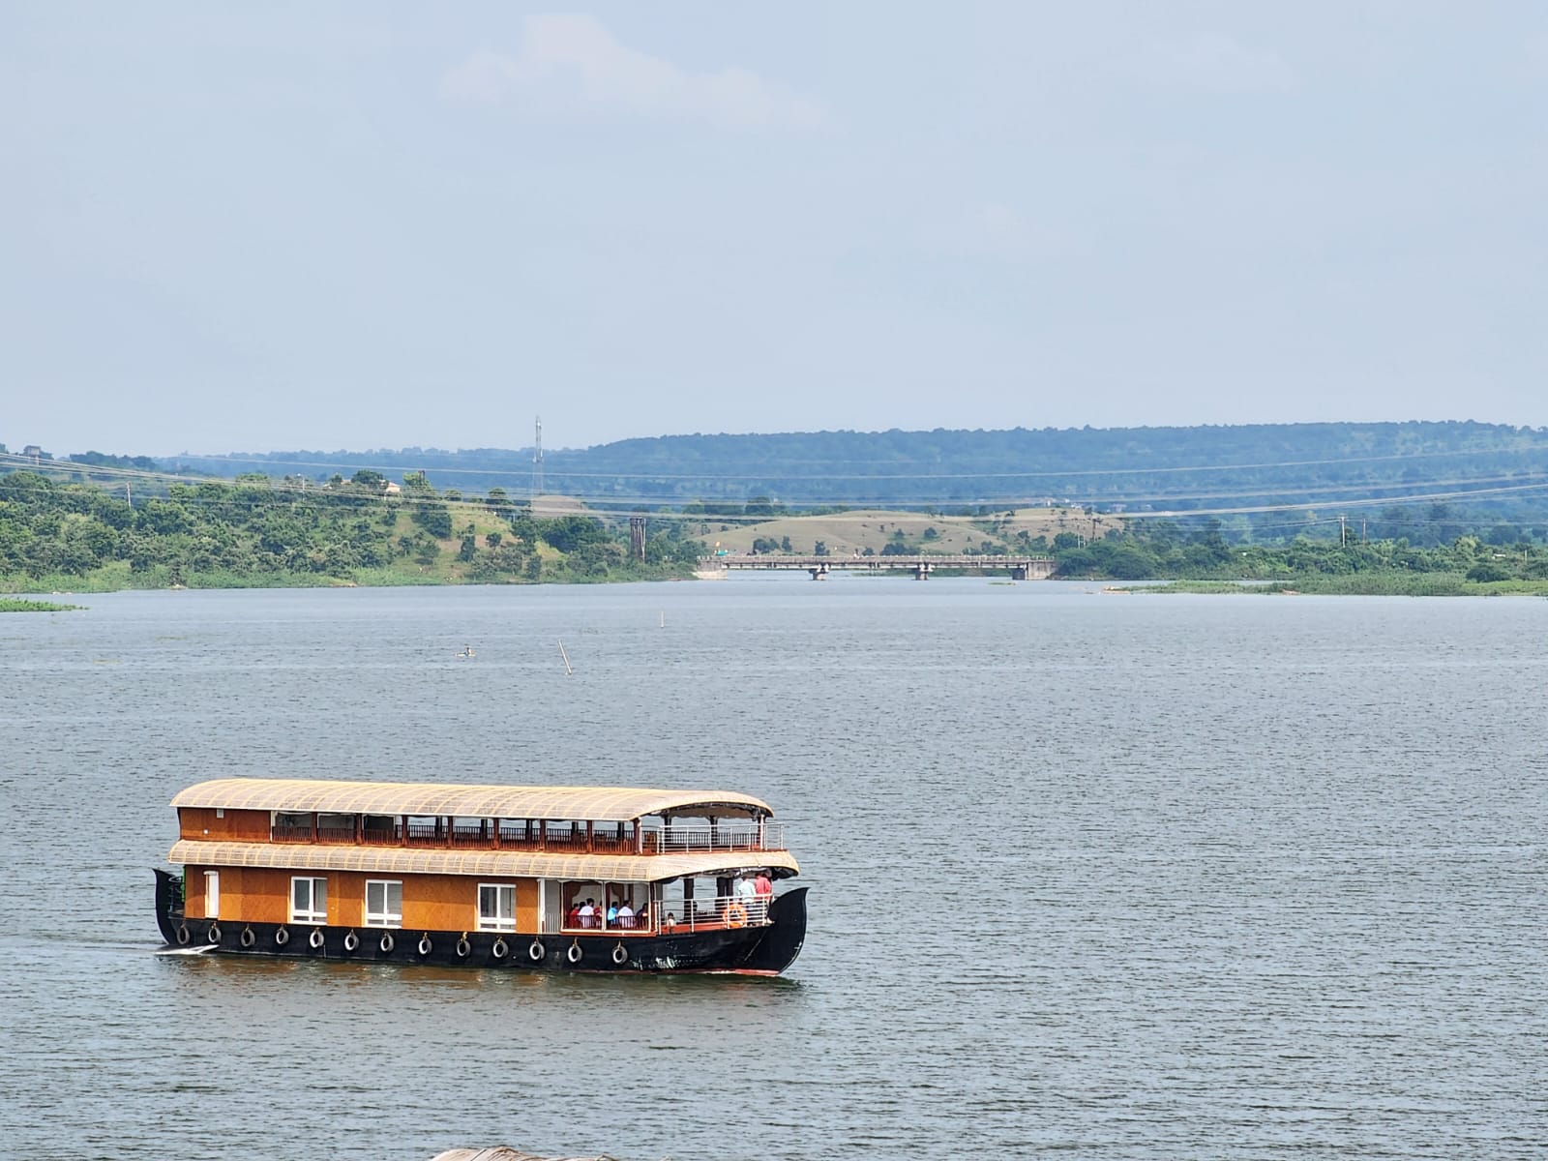
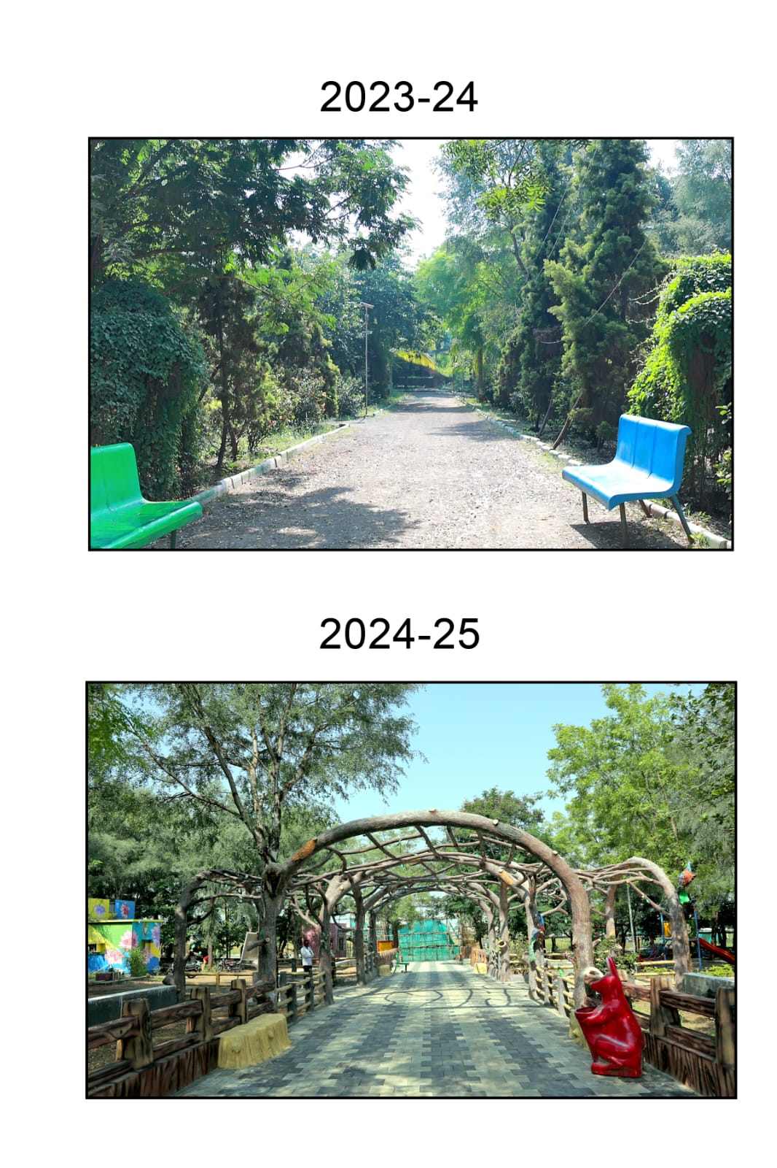
Tourism Development
Garkheda, Tal Jalmner
Landorkhori Forest garden, Jalgaon

Slide 33
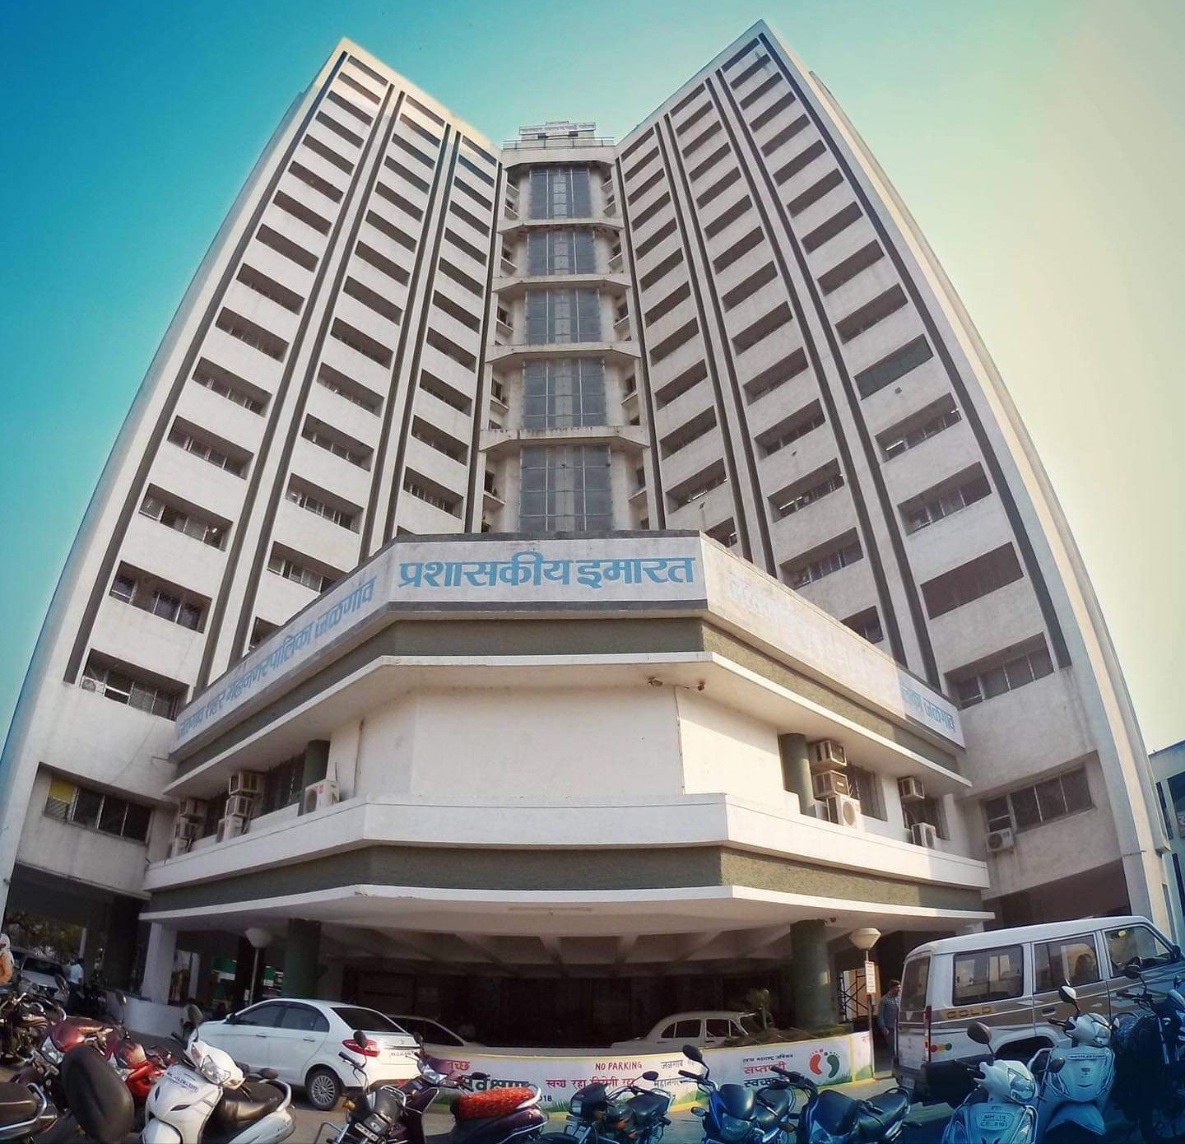
Part 6 - Urban Development

Slide 34

City Development – Four major cities
Total Population of 4 Major Cities in Jalgaon – 8,97,394
Existing MIDC’s in Jalgaon, Bhusawal, Chalisgaon
Proposed Development
* Area Increase / Extention
* City Plan
* Subsidies on Social Infrastructure
Economic Growth :
Focus on improving existing industrial zones (like MIDC) with better infrastructure.
Encourage public-private partnerships (PPP) to boost the agricultural and food processing sectors
Promote small-scale industries like plastic manufacturing, Gold, and textile, Plastic production through special economic zones or industrial hubs with good power Subsidies
Support for soft infrastructure and retail market
E- bus initiative in urban area
Land Allotment subsidy
Bhusaval
Jalgaon
Amalner
Chalisgaon

Slide 35
Other Initiatives

Slide 36
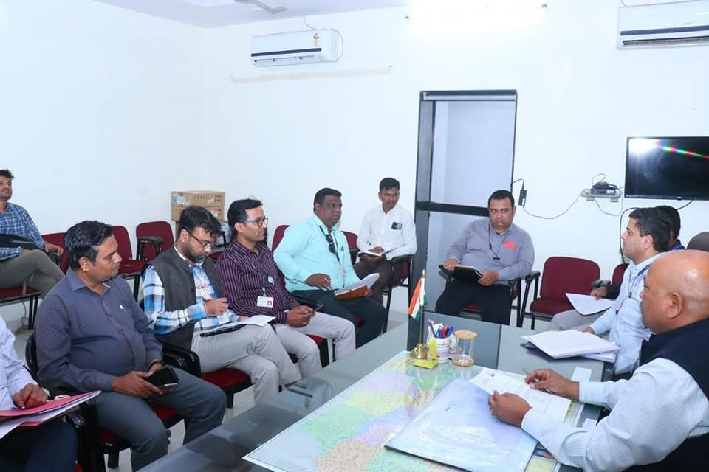
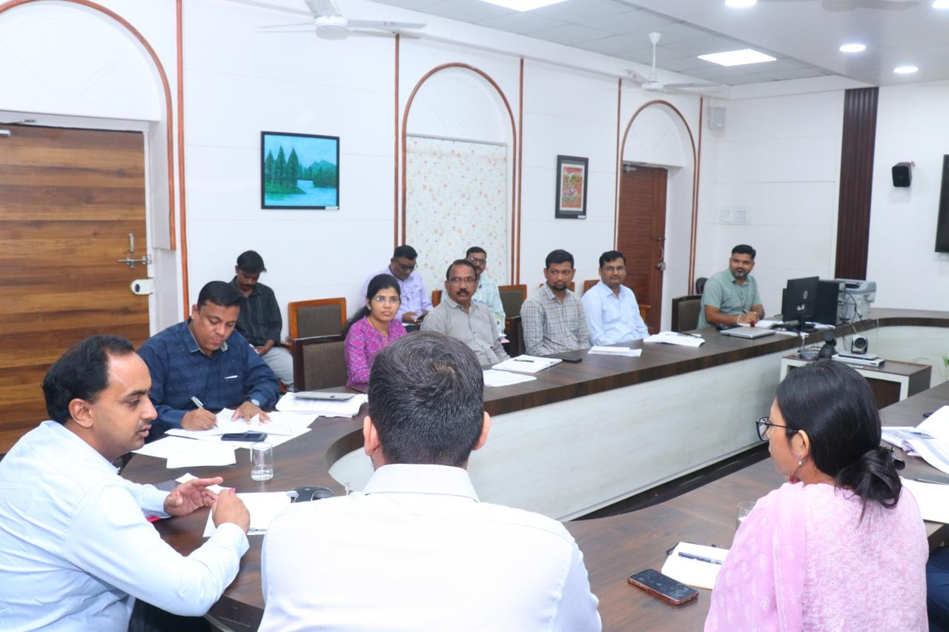
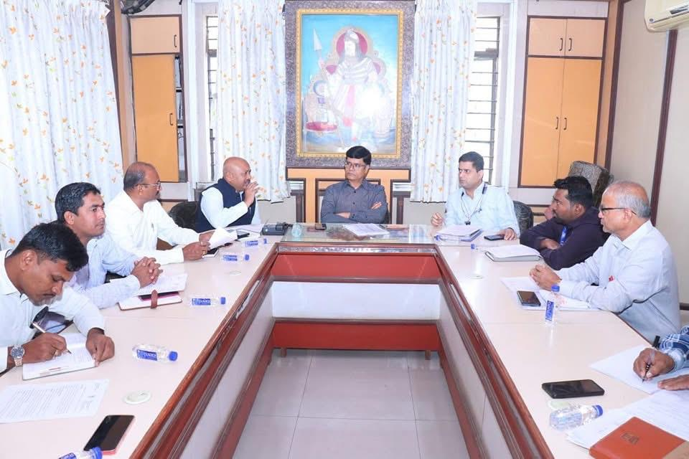
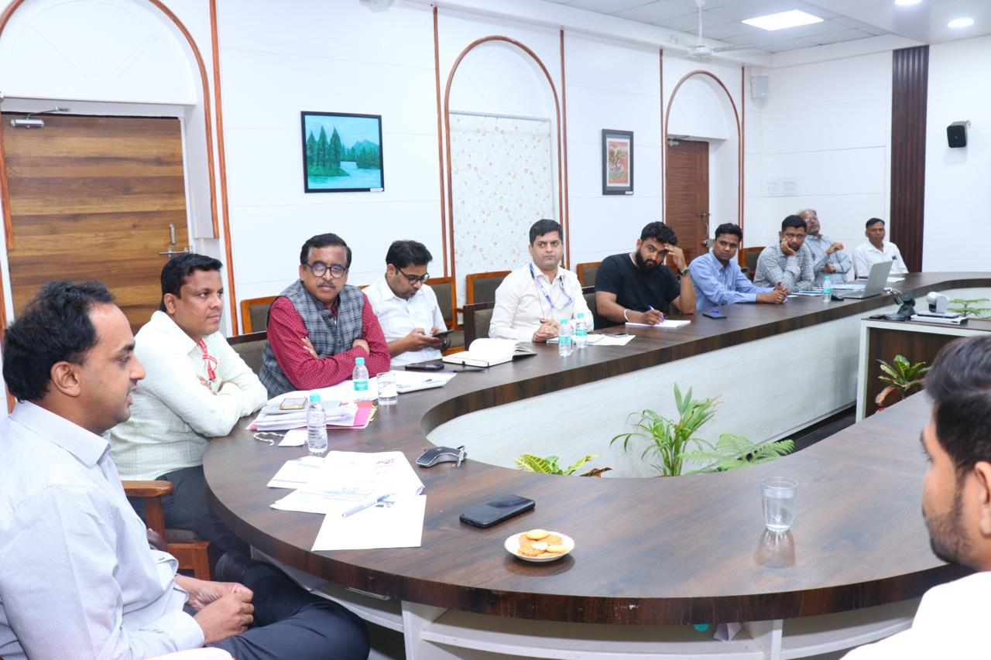
Bank One to One Meetings
DSP Meetings
Objective :
To increase CD Ratio with Big Loans 2. Increase in KCC Accounts
3. To Conduct 2 week Campaign for PMFME, CMEGP, PMEGP, SHG Loans 4. To Encourage Banks for distribution Of Education Loans
5. To encourage Banks for Providing Smooth Loan Facilities to the entrepreneur

Slide 37

Thank You

